Slide 1
KL UNIVERSITY
Design and Simulation of a Digital
Access Verification System
Using XOR / XNOR Logic
BATCH 13
Presented by: Tanish (2620080073) • Vrithika (2620080089) • Sujeet (2620090014) • Prakash (2620080060) • Meghana (2620080049)
Module 1 — Digital Logic Fundamentals
Notes:
<number>

Slide 2
Agenda
Introduction to Access Verification Systems
Module 1 Recap — Basic Logic Gates
1
2
XOR Gate — Working & Truth Table
XNOR Gate — Working & Truth Table
3
4
Bit-Comparator Concept for Access Checking
System Block Diagram
5
6
Circuit Diagram (Simulated in Logisim)
Applications, Advantages & Conclusion
7
8
Batch 13 | KL University
2
Notes:
<number>

Slide 3
What is a Digital Access Verification System?
A circuit that checks whether an ENTERED CODE matches a STORED (authorized) CODE, and grants or denies access based on the result — the same logic used in keypad locks, ID card readers and PIN checks.
1
2
3
Input
Compare
Decide
User enters a binary code (e.g. 4-bit password)
XOR/XNOR gates compare each bit with the stored code
AND gate combines results → output tells match / no match
Batch 13 | KL University
3
Notes:
<number>

Slide 4
Module 1 Recap — Basic Logic Gates
AND
OR
NOT
XOR
XNOR
Y = A . B
Y = A + B
Y = A̅
Y = A ⊕ B
Y = (A ⊕ B)̅
Output is 1 only if all inputs are 1
Output is 1 if any input is 1
Output is the inverse of the input
Output is 1 only if inputs are DIFFERENT
Output is 1 only if inputs are SAME
This project focuses on XOR and XNOR — the two gates used to build the bit comparator.
Batch 13 | KL University
4
Notes:
<number>

Slide 5
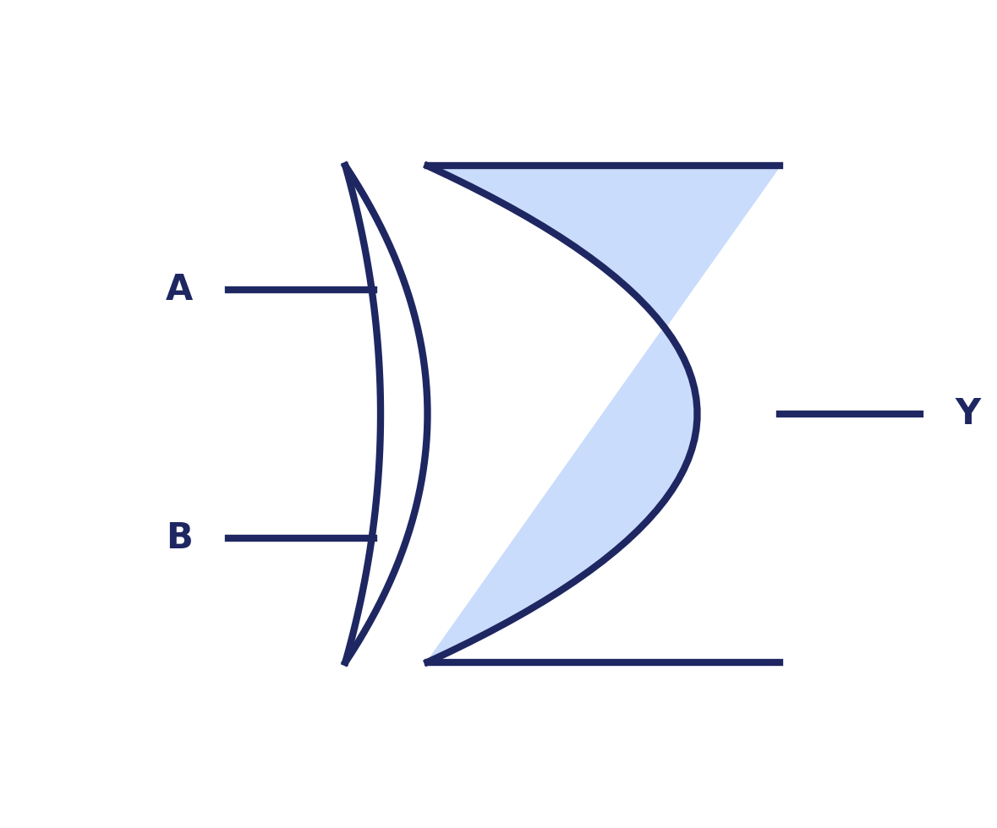
XOR Gate
A | B | Y
0 | 0 | 0
0 | 1 | 1
1 | 0 | 1
1 | 1 | 0
Boolean Expression: Y = A ⊕ B
In access verification, XOR flags a MISMATCH: if the entered bit and the stored bit are different, XOR outputs 1 (error / no match) for that bit position.
Batch 13 | KL University
5
Notes:
<number>

Slide 6
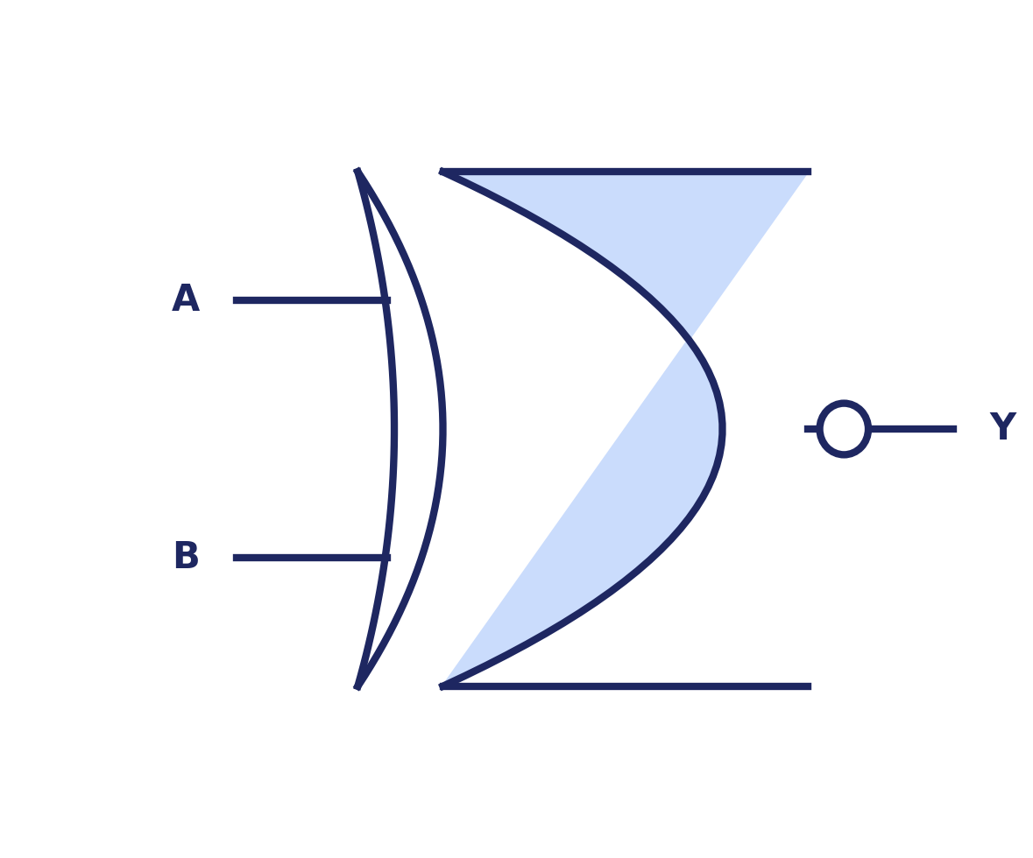
XNOR Gate
A | B | Y
0 | 0 | 1
0 | 1 | 0
1 | 0 | 0
1 | 1 | 1
Boolean Expression: Y = (A ⊕ B)̅
XNOR flags a MATCH: if the entered bit and the stored bit are the SAME, XNOR outputs 1. This is why XNOR is the natural choice for a bit comparator.
Batch 13 | KL University
6
Notes:
<number>

Slide 7
Bit-Comparator Concept for Access Checking
Each bit of the entered code is compared with the corresponding bit of the stored code using an XNOR gate.
Entered Code (A)
1 0 1 1
XNOR Result:
1 1 1 1
XNOR each bit →
Stored Code (B)
1 0 1 1
AND all XNOR outputs together → if the result = 1, EVERY bit matched → ACCESS GRANTED.
If even ONE bit differs, the AND output = 0 → ACCESS DENIED.
Batch 13 | KL University
7
Notes:
<number>

Slide 8
System Block Diagram
Keypad / Switches
(Entered Code)
Stored Code
(Reference Register)
XNOR Comparator
(bit-by-bit)
AND Gate
(final decision)
LED / Buzzer
Output
Two independent inputs (entered code and stored code) are compared bit-wise; the combined result drives a visible/audible output.
Batch 13 | KL University
8
Notes:
<number>

Slide 9
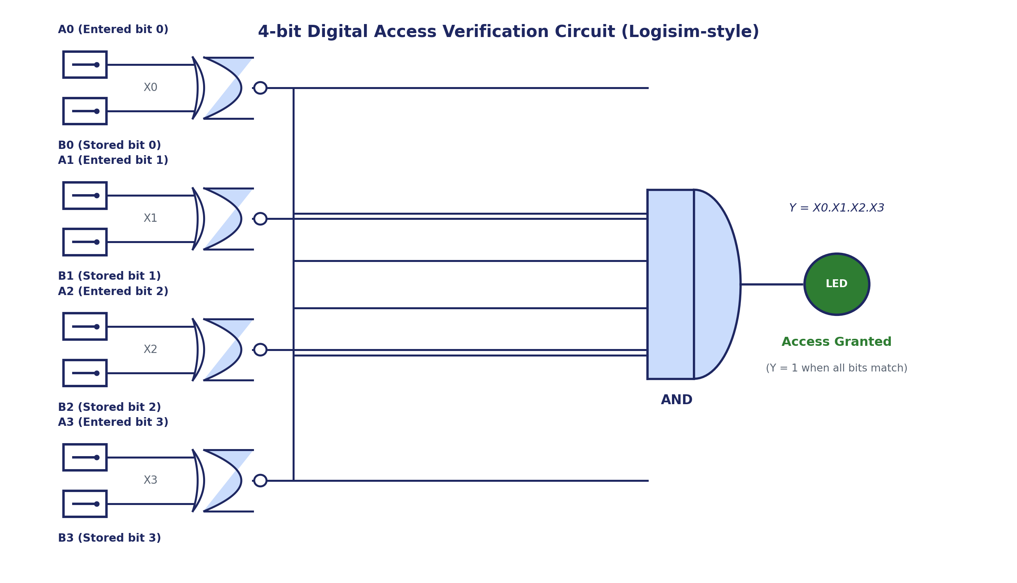
Circuit Diagram — Simulated in Logisim
Batch 13 | KL University
9
Notes:
<number>

Slide 10
Worked Example — 4-bit Code Check
Case 1: Correct Code Entered
Case 2: Wrong Code Entered
Bit | A (Entered) | B (Stored) | XNOR Output
0 | 1 | 1 | 1
1 | 0 | 0 | 1
2 | 1 | 1 | 1
3 | 1 | 1 | 1
Bit | A (Entered) | B (Stored) | XNOR Output
0 | 1 | 1 | 1
1 | 1 | 0 | 0
2 | 1 | 1 | 1
3 | 1 | 1 | 1
AND = 1 → ACCESS GRANTED
AND = 0 → ACCESS DENIED
Batch 13 | KL University
10
Notes:
<number>

Slide 11
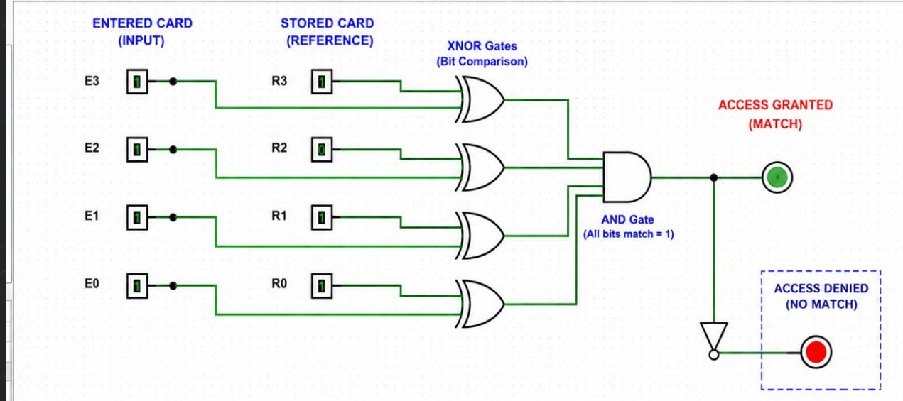

Slide 12
Applications
Digital door locks & keypad entry systems
ATM PIN and card verification circuits
1
2
Password-protected embedded devices
Employee ID / RFID access control panels
3
4
Vehicle immobilizer / anti-theft systems
Secure locker and safe-box mechanisms
5
6
Batch 13 | KL University
11
Notes:
<number>

Slide 13
Advantages & Limitations
Advantages
Limitations
Simple, low gate-count design
Fast comparison — works in real time
Easy to scale to more bits (8, 16...)
Low power and low cost to build
Easy to simulate and test in Logisim
Fixed code is hardwired / not easily changed
No encryption — code is compared in plain bits
Vulnerable to physical tampering
Limited to simple match / no-match logic
Batch 13 | KL University
12
Notes:
<number>

Slide 14
Conclusion
1
XOR and XNOR gates provide a simple and reliable way to compare digital codes bit by bit.
2
XNOR's “match = 1” behaviour makes it ideal for building an access/password comparator.
3
Combining XNOR outputs with a single AND gate gives one clean Grant / Deny signal.
4
The design was verified using truth tables and simulated successfully in Logisim.
Batch 13 | KL University
13
Notes:
<number>

Slide 15
KL UNIVERSITY
Presented By — Batch 13
T
V
S
P
M
Tanish | 2620080073
Vrithika | 2620080089
Sujeat | 2620090014
Prakash | 2620080060
Meghana | 2620080049
Thank You
Digital Access Verification System Using XOR / XNOR Logic | Module 1
github.com/tanishsharma73/KLH-FED-2026-SESSION13-BATCH-13
Notes:
<number>

